Slide 1
Automated Regression Testing
Jeremy Lerch
Afshin Chaharmahalian

Slide 2
Purpose
Provide an overview of automated testing using the Selenium web automation framework

Slide 3
Agenda
SeleniumHQ Overview
Selenium IDE
Demonstration
Questions

Slide 4
SeleniumHQ Browser Automation
Software testing framework for web applications
Provides an easy way to automate tasks in a web browser
Can be run against multiple browsers (Firefox, Chrome, Safari, IE, Opera) on multiple operating systems (Windows, OSX, Linux)
Three main components:
Selenium IDE*
Selenium Web Driver
Selenium Remote Control

Slide 5
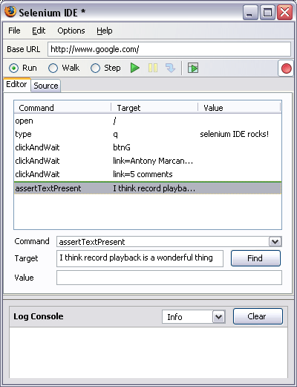
Selenium IDE
Firefox Browser Extension
Allows for recording or manually editing test cases
Test can be played back individually or as an entire test suite
Tests can be saved in multiple formats (we are using HTML)

Slide 6
Demonstration

Slide 7
Questions

